Slide 1
CHAPTER 12 (Part 3)
Abstract Data Type

Slide 2
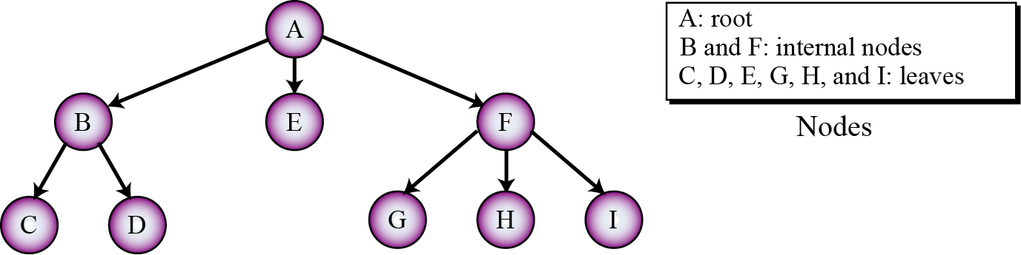
12-5 TREES
A tree consists of
A finite set of elements, called nodes (or vertices)
A finite set of directed lines, called arcs, that connect pairs of the nodes
Figure 12.20 Tree representation

Slide 3
Three categories of vertices in a tree
Root
Leaves
Internal nodes

Slide 4
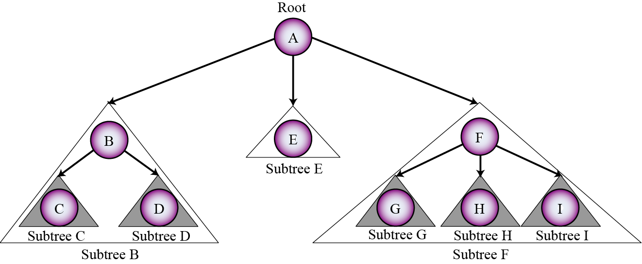
Each node in a tree may have a subtree
One of its children and
All descendents of that child
Figure 12.21 Subtrees

Slide 5
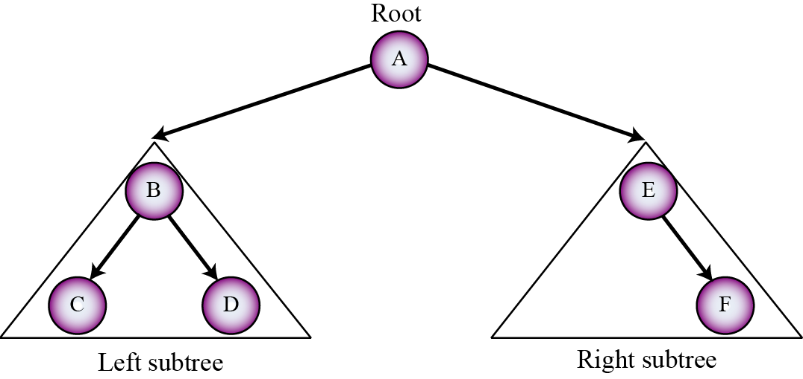
12-5.1 BINARY TREES
A binary tree
A tree in which no node has more than two subtrees
So, a node can have zero, one, or two subtrees
Figure 12.22 A binary tree

Slide 6
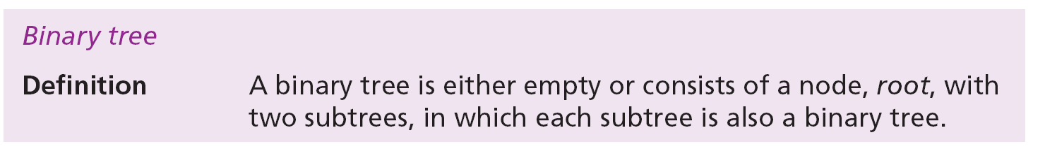
Recursive definition of binary trees
In Chapter 8 we saw recursive algorithm definitions
We can also define many ADTs recursively
For example a binary tree
Note that a binary tree has a root, but each subtree also has a root

Slide 7
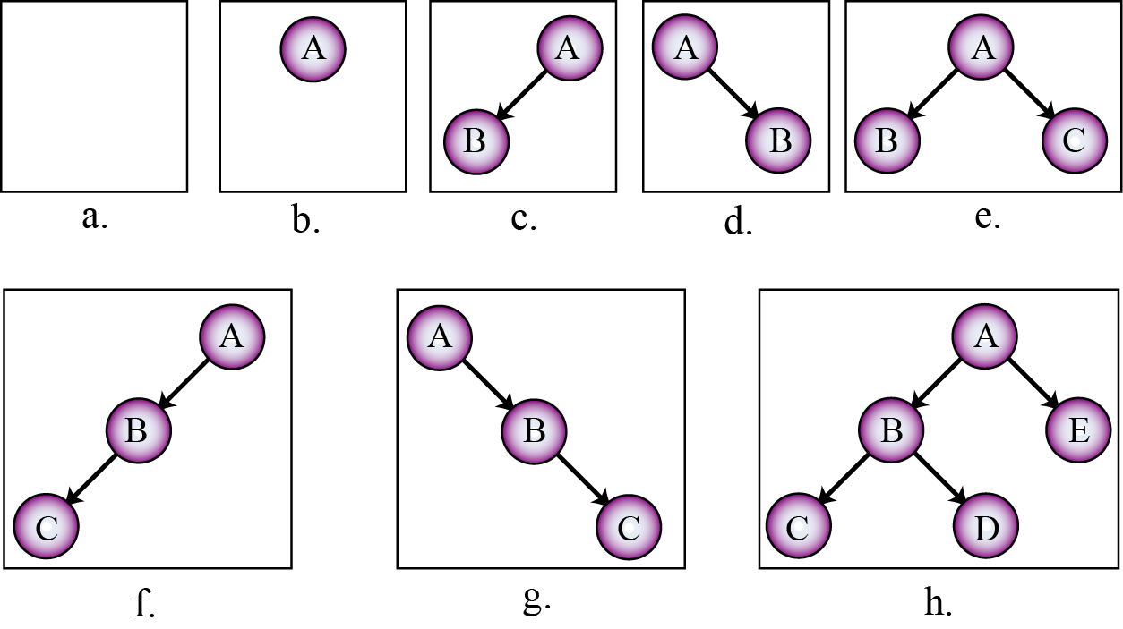
Eight example binary trees
The first is an empty binary tree (a null binary tree)
Figure 12.23 Examples of binary trees

Slide 8
12.5.2 Operations on binary trees
The six most common operations for a binary tree
The tree operation (creates an empty tree)
The insert operation
The delete operation
The retrieve operation
The empty operation
The traversal operation
First five are complex and beyond the scope of this book

Slide 9
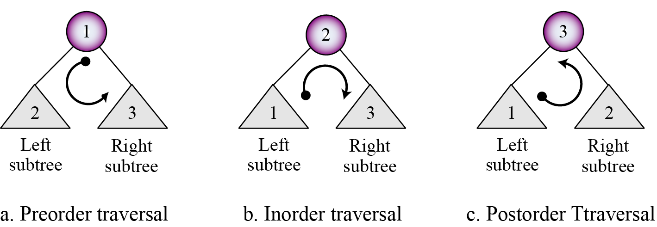
Binary tree traversals
A binary tree traversal
Each tree node is processed once and only once in a predetermined sequence
Two general approaches to the traversal sequence
Depth-first
Breadth-first
Figure 12.24 Depth-first traversal of a binary tree

Slide 10
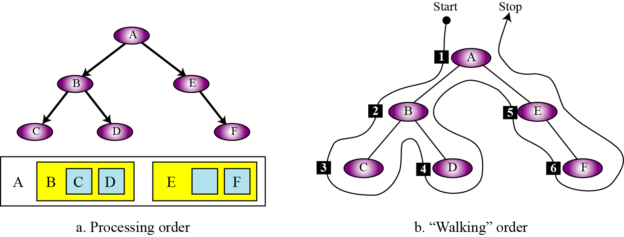
Example 12.10
Figure 12.25 shows
Visiting tree nodes with depth-first preorder traversal
The walking order: The order nodes are visited
In this example: A, B, C, D, E, F
Figure 12.25 Example 12.10

Slide 11
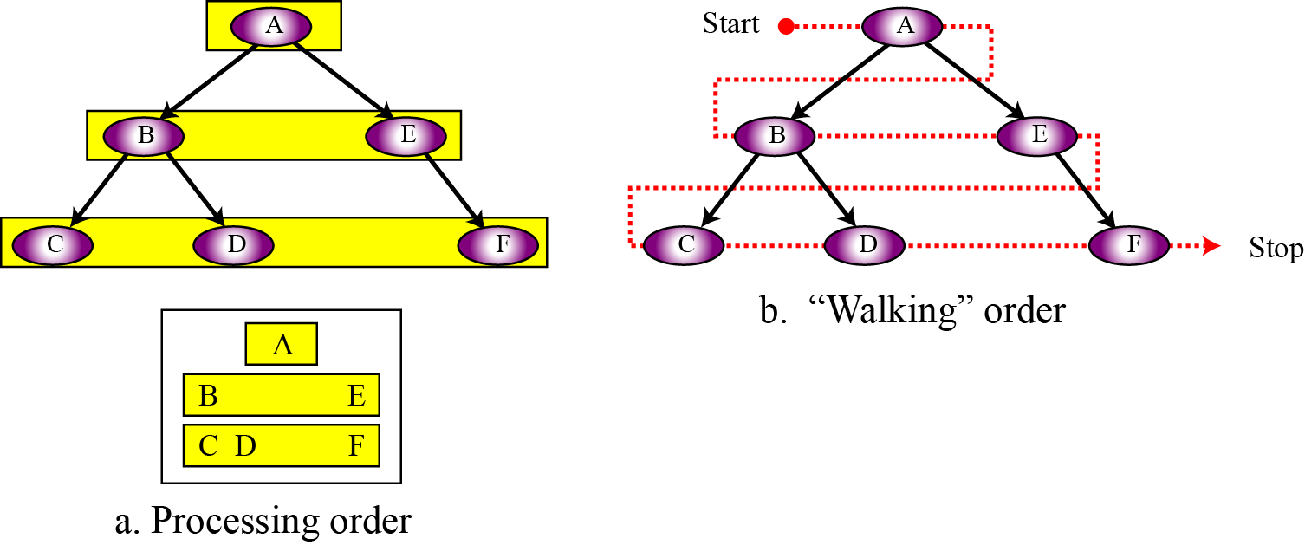
Example 12.11
Figure 12.26 shows
Visiting tree nodes with breadth-first traversal
The walking order: The order nodes are visited
In this example: A, B, E, C, D, F
Figure 12.26 Example 12.11

Slide 12
12.5.3 Binary tree applications
Binary trees have many applications in computer science
Here we mention only two of them
Huffman coding
Expression trees
Huffman coding
Huffman coding is a compression technique
Uses binary trees to generate a variable length binary code from a string of symbols
Huffman coding is discussed in detail in Chapter 15

Slide 13
Expression trees
An arithmetic expression
Can be represented in three different formats
​Infix
Operator comes between the two operands
​Postfix
Operator comes after its two operands
​Prefix
Operator comes before the two operands
For the + operator and operands A and B:

Slide 14
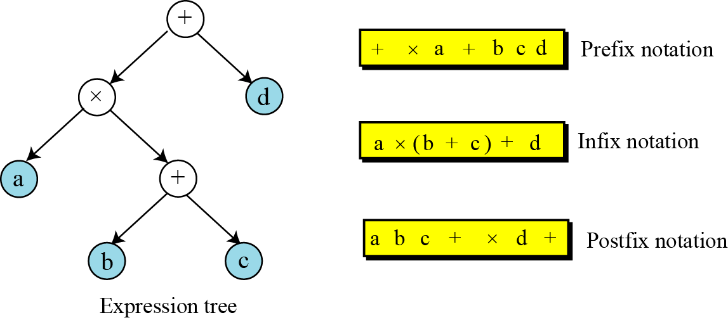
Figure 12.27 Expression tree

Slide 15
12.5.4 Binary tree implementation
Binary trees can be implemented using
An array or
A linked representation similar to a linked list
Nodes with pointers to subtrees
More efficient for insertion and deletion
More prevalent

Slide 16
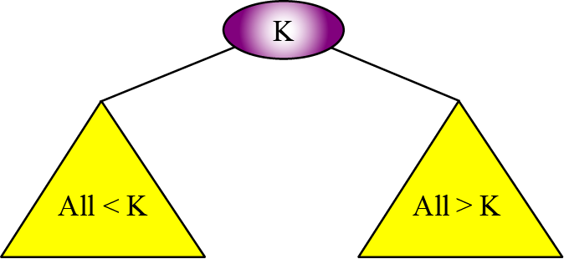
12-5.5 BINARY SEARCH TREES
A binary search tree (BST) is a binary tree
Key value of each node n
Greater than the key values of all nodes in n’s left subtree
Smaller than the value of all nodes in n’s right subtree
Figure 12.28 Binary search tree (BST)

Slide 17
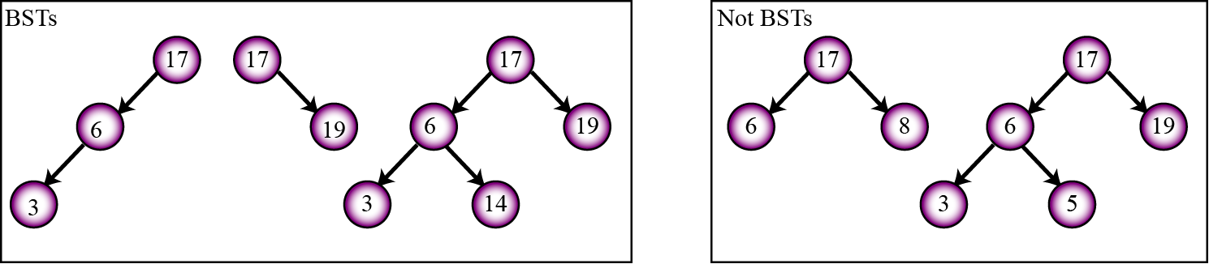
Figure 12.29 Example 12.12

Slide 18
A very interesting property of a BST
If we apply the inorder traversal of a binary tree
Elements visited are sorted in ascending order
For example
Consider the following BSTs
When traversed inorder, gives the lists
(3, 6, 17)
(17, 19)
(3, 6, 14, 17, 19)

Slide 19
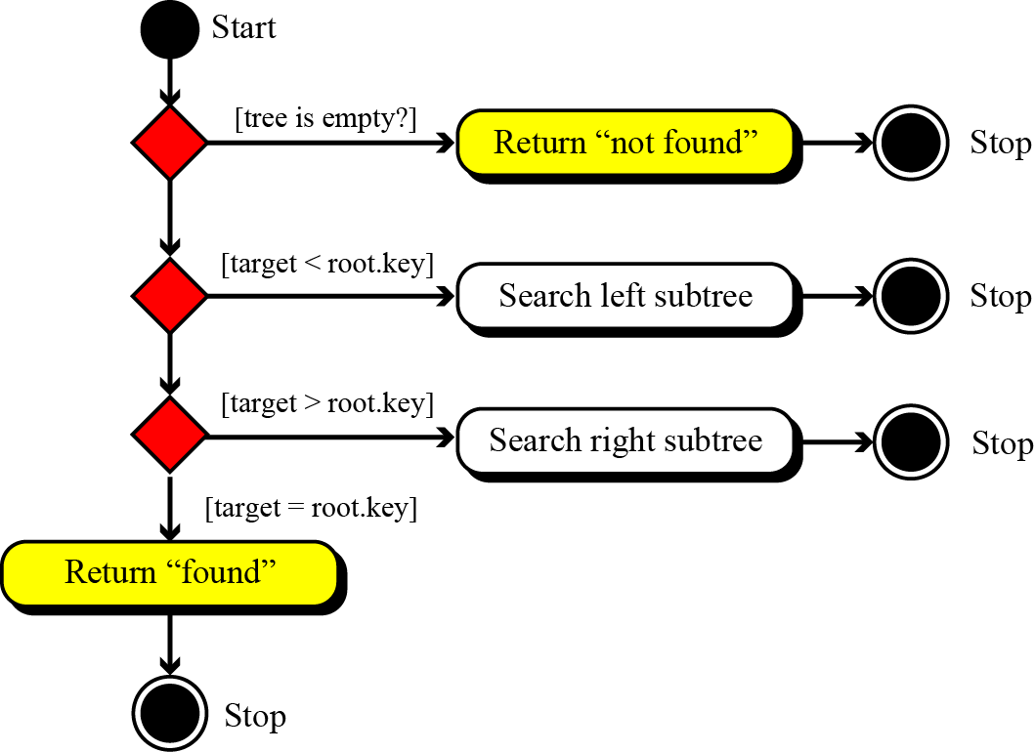
We can easily use BSTs for a binary search
A recursive search based on the current node’s key
Figure 12.30 Inorder traversal of a binary search tree

Slide 20
Binary search tree ADTs
The ADT for a binary search tree
Similar to general linear list with same operations
Searching more efficient for a BST than a linear list
A general linear list uses sequential searching
A BST uses a binary search

Slide 21
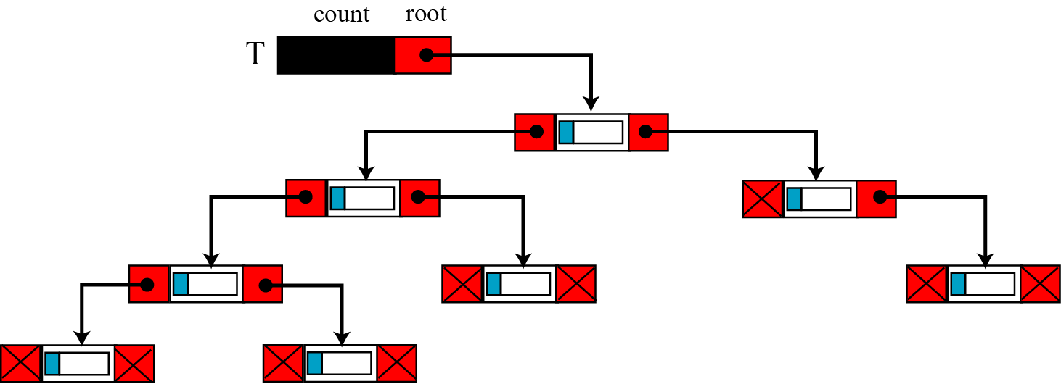
BST implementation
A BST can be implemented using
An array
A linked representation similar to a linked list
Nodes with two pointers, left and right
More common
More efficient
Figure 12.31 A BST implementation

Slide 22
12-8 GRAPHS
A graph is an ADT made of
Nodes, called vertices
Lines connecting two vertices, called edges or arcs
A tree defines a hierarchical structure
A node can have only one single parent
A graph defines a non-hierarchical structure
Each node can be connected to any number of nodes
Graphs may be either
Directed (a digraph)
Each edge has a direction from one vertex to next
Undirected
Edges have no direction

Slide 23
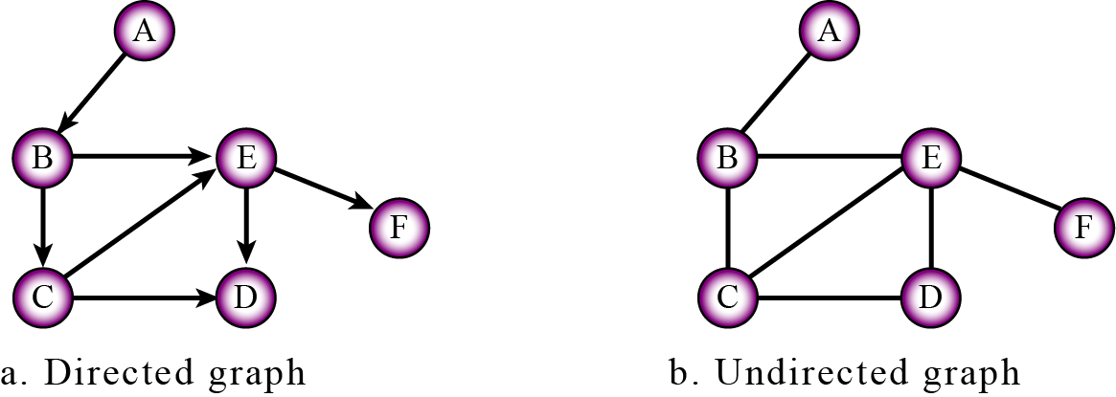
Figure 12.32 Graphs

Slide 24
Example 12.13
A map of cities and the roads connecting the cities
Can be represented using an undirected graph
Cities are vertices
Undirected edges are the roads that connect cities
If we want to show the distances between the cities
Can use weighted graphs
Each edge has a weight that represent a distance
Example 12.14
Computer networks
Can be represented using a graph
Nodes or hubs are vertices
Edges can represent a connection
Weight is cost of transmission from one hub to another
A router can use graph algorithms to find the shortest path between itself and the final destination of a packet

